Slide 1
Research Questions
What are the predictive powers of different drivers (chemical and physical) of algal blooms in Loch Leven?
How does these influence the composition of phytoplankton communities?
How does seasonality influence the occurrence of algal blooms?

Slide 2
Variables | Ranking for lmer | References | Notes
SRP | 1 | 10.1007/s10750-011-0923-x 10.1111/j.1365-2427.2007.01865.x 10.1080/20442041.2020.1827891 10.1007/s10750-013-1525-6 10.1016/j.ecolind.2022.109560 10.1016/j.hal.2019.02.002 | Nutrient availability (10.1016/j.envpol.2020.116210)
SD | 9 | 10.1007/s10750-011-0923-x
NO3 | 3 | 10.1007/s10750-011-0996-6 10.1007/s10750-013-1525-6 10.1016/j.ecolind.2022.109560 10.1016/j.hal.2019.02.002 | Total N played a more important role for phytoplankton richness than total P (10.1007/s10750-011-0996-6)
Salinity |  | 10.3390/w15061116 | Talks about salinity in brackish coastal lakes – relevant?
Daphnia | 4 | 10.100 7/s10750-011-0923-x
DO | 8 | 10.1080/20442041.2020.1827891
pH | 5 | 10.1007/s10750-013-1525-6 10.1016/j.ecolind.2022.109560
Temperature | 6 | 10.1007/s10750-011-0923-x 10.1080/20442041.2020.1827891 | Some found that temperature had little effect (10.1111/j.1365-2427.2007.01865.x) Spilt findings
Water Depth | 7 | 10.1016/j.ecolind.2022.109560
Phytoplankton Group | 2
Season | 2 | 10.1016/j.ecolind.2022.109560 | the plankton community was the least diverse in winter and the most stable during the spring-to-summer transition

Slide 3
Model No | Response Variable | Fixed Effects | Interaction | Random Effects | Dataset
1 | Total.Biovolume | SRP | - | Year | alldata
2 | Biovolume | SRP, Season, Phytoplankton Group | - |  | alldatalong
3 |  | SRP, Season, Phytoplankton Group | Season*PhytoplanktonGroup
4 |  | SRP, Season, Phytoplankton Group, NO3
5 |  | SRP, Season, Phytoplankton Group, NO3, Daphnia
6 |  | SRP, Season, Phytoplankton Group, NO3, Daphnia, pH
7 |  | SRP, Season, Phytoplankton Group, NO3, Daphnia, pH, Temperature
8 |  | SRP, Season, Phytoplankton Group, NO3, Daphnia, pH, Temperature, Water Depth
9 |  | SRP, Season, Phytoplankton Group, NO3, Daphnia, pH, Temperature, Water Depth, DO
10 |  | SRP, Season, Phytoplankton Group, NO3, Daphnia, pH, Temperature, Water Depth, DO, SD

Slide 4
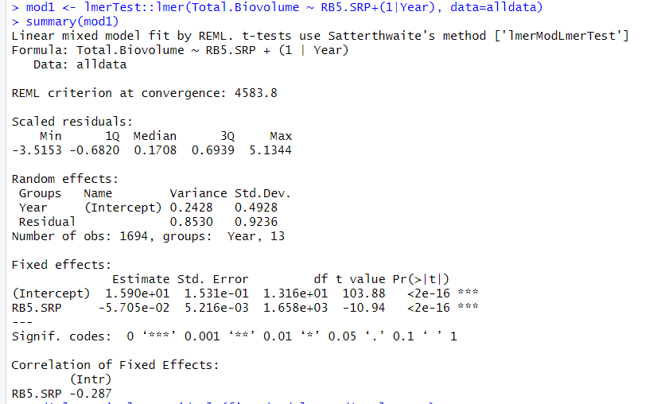

Slide 5
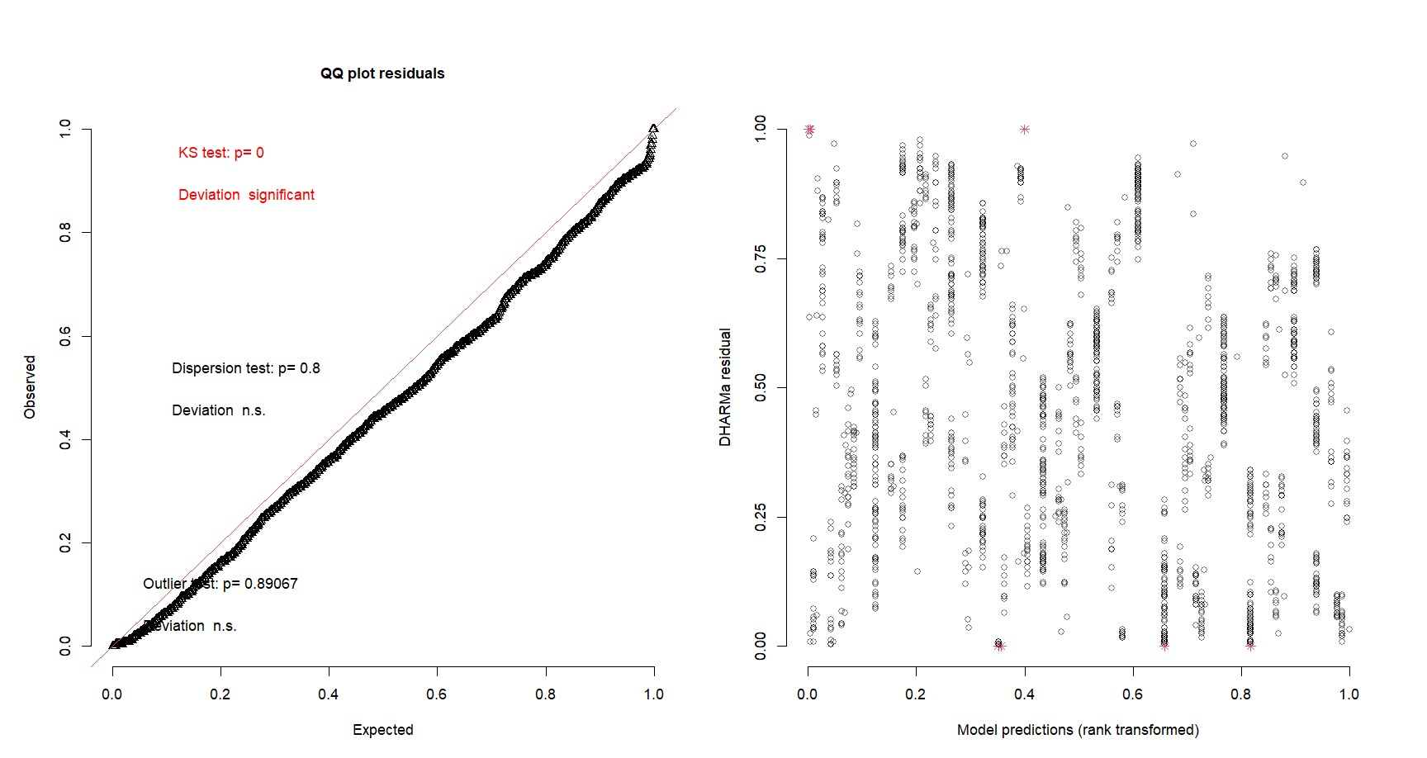

Slide 6
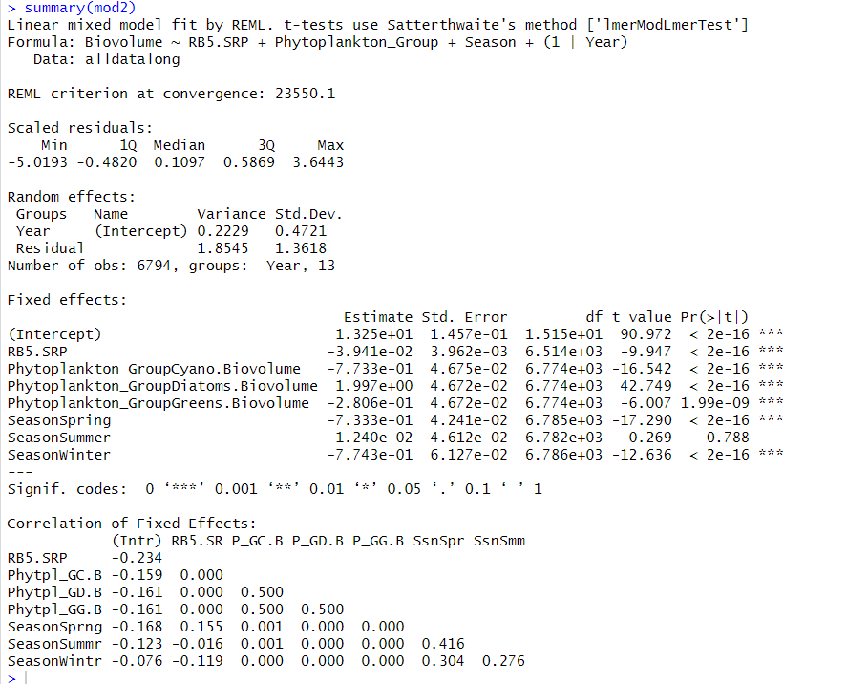

Slide 7
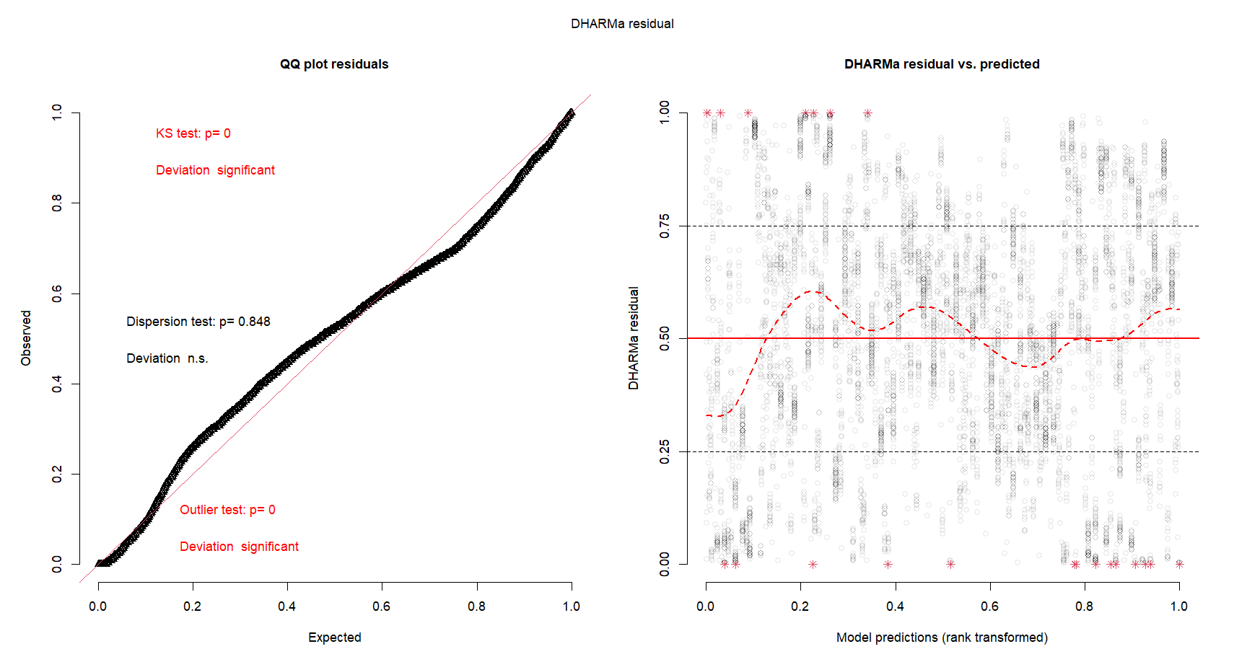

Slide 8
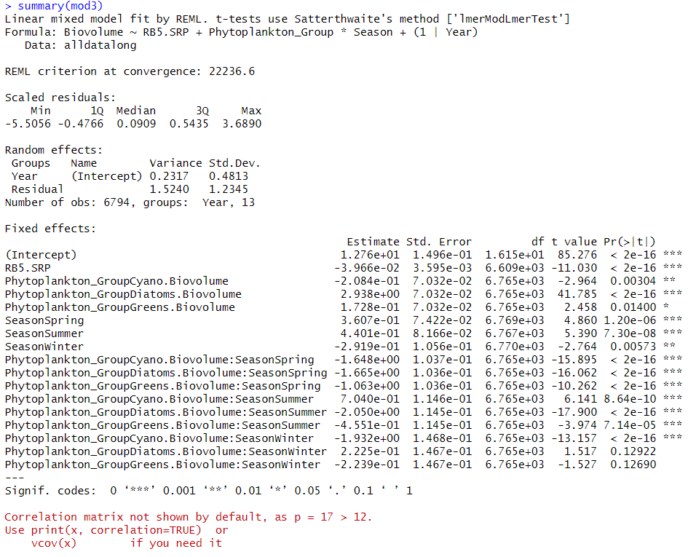

Slide 9
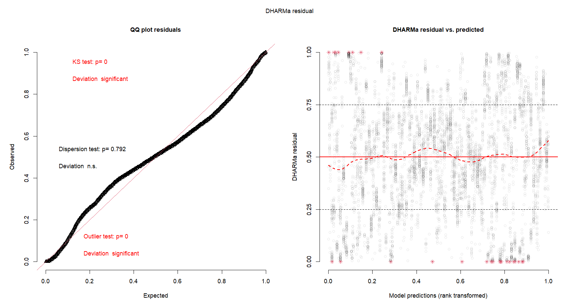

Slide 10
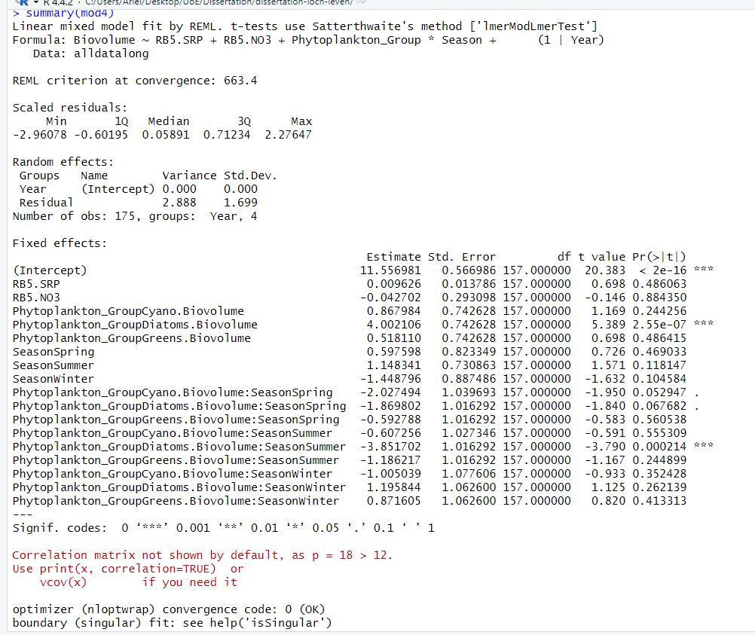

Slide 11
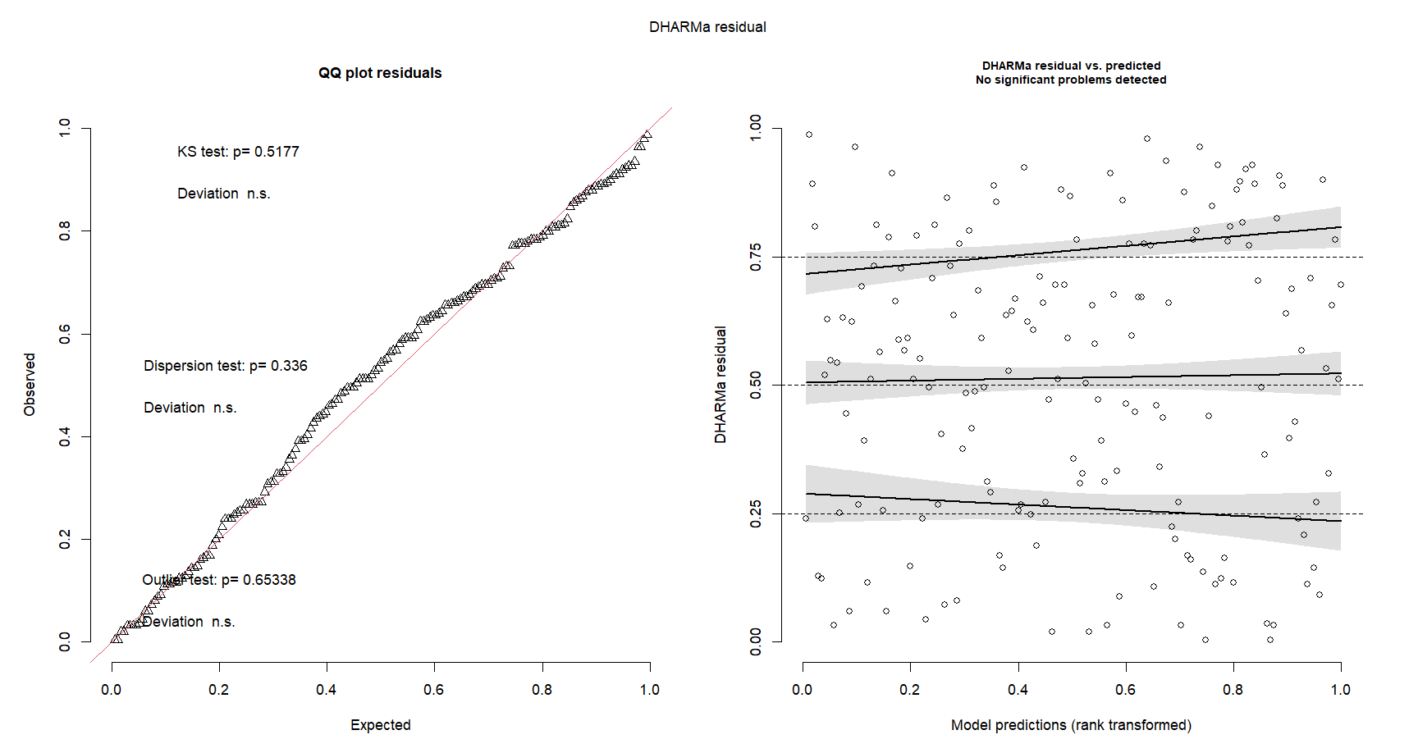

Slide 12
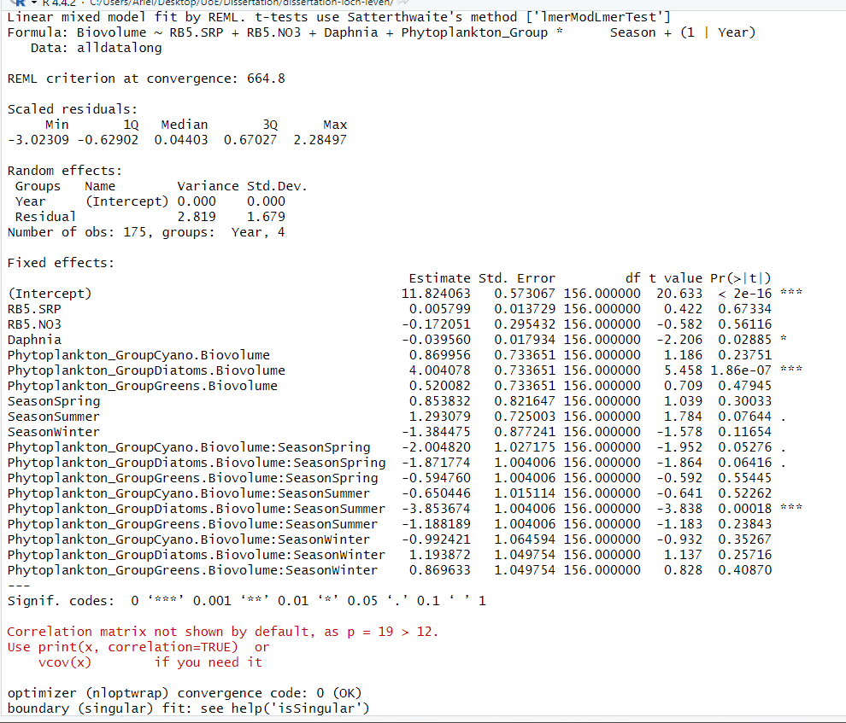

Slide 13
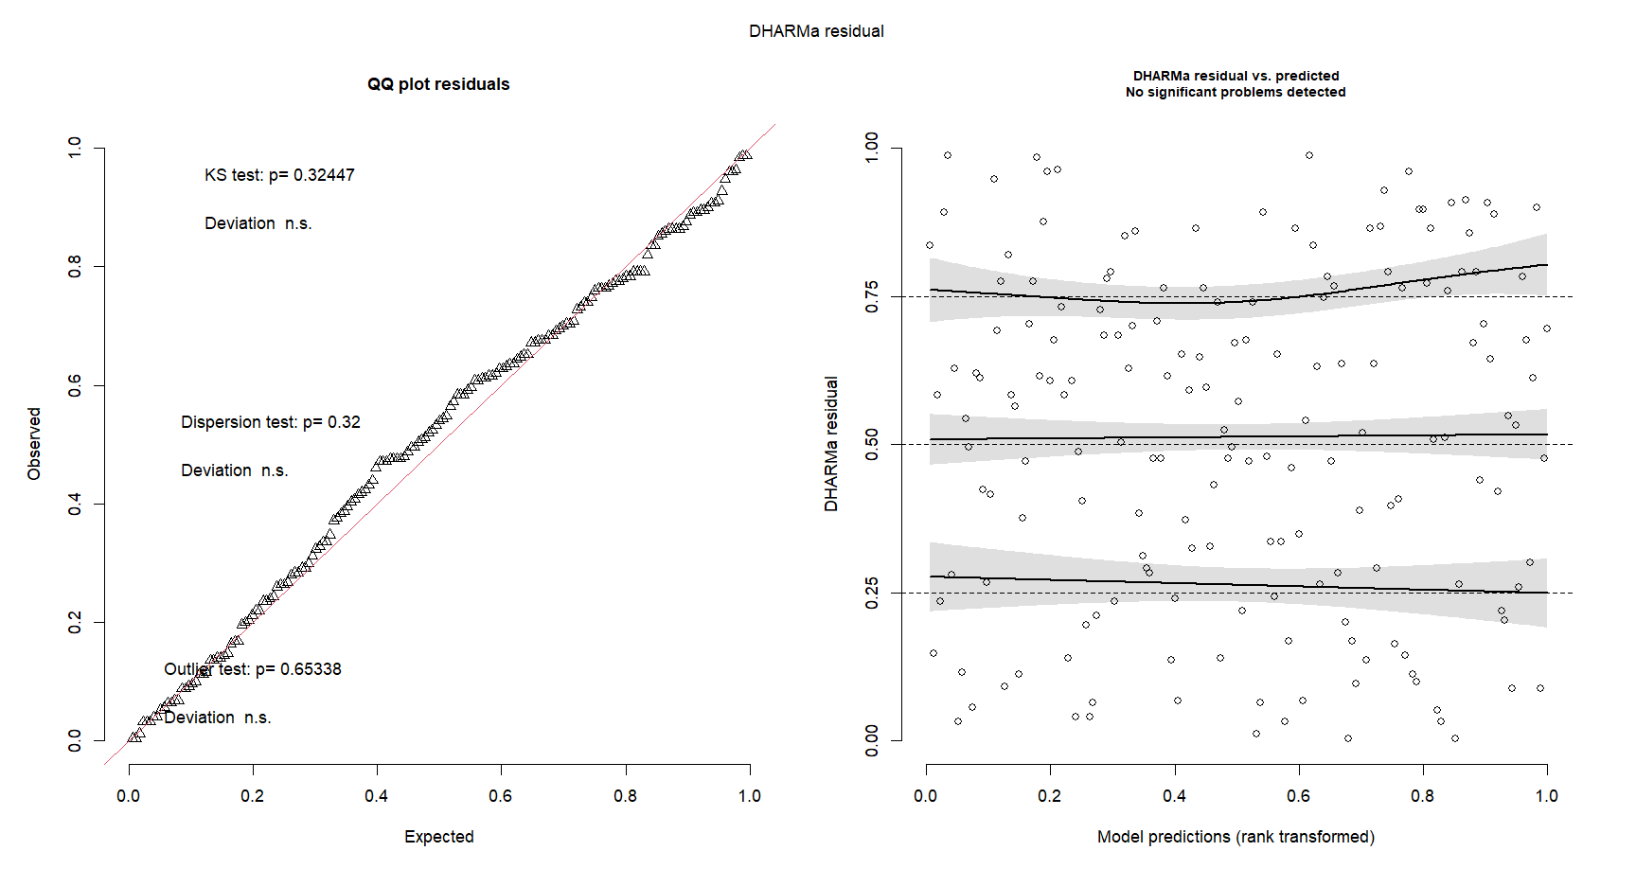

Slide 14
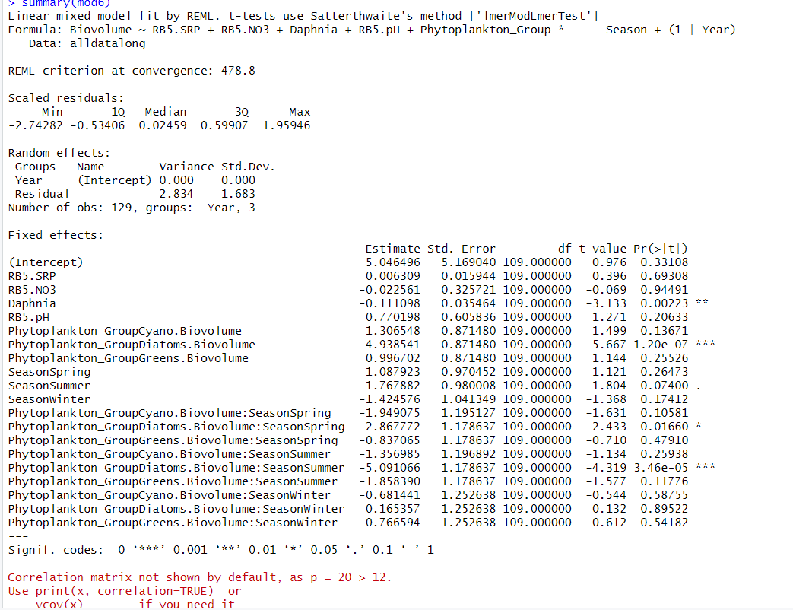

Slide 15
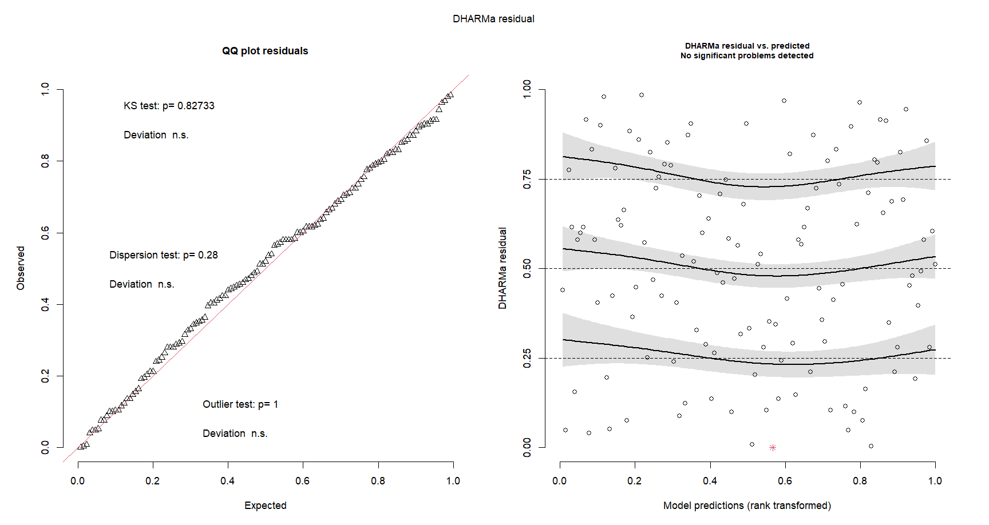

Slide 16
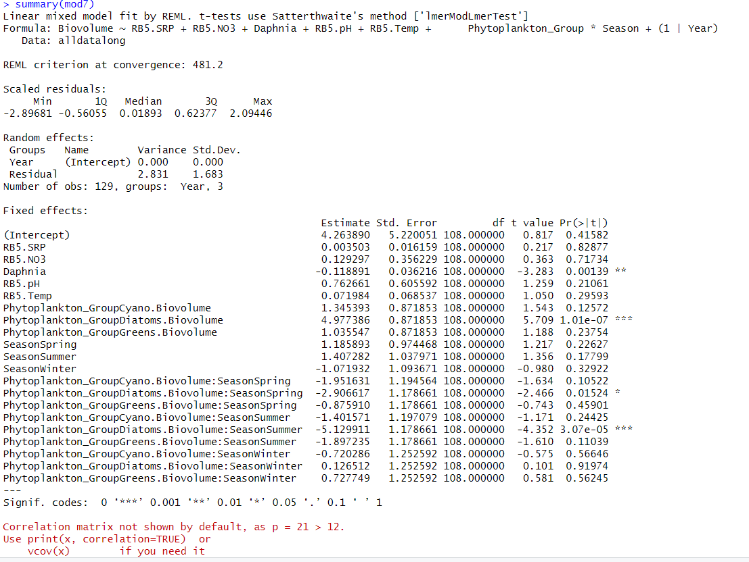

Slide 17
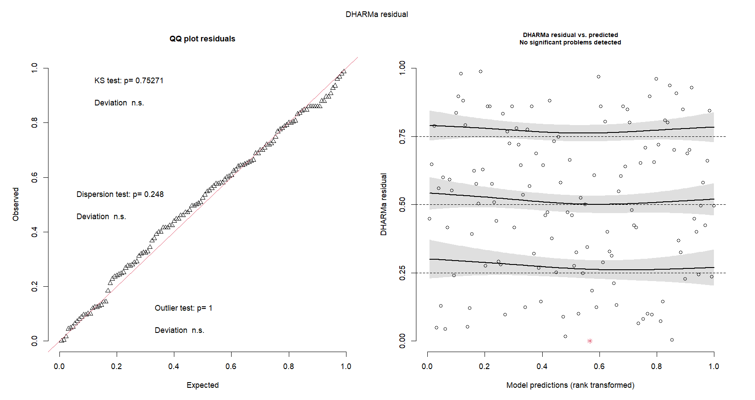

Slide 18
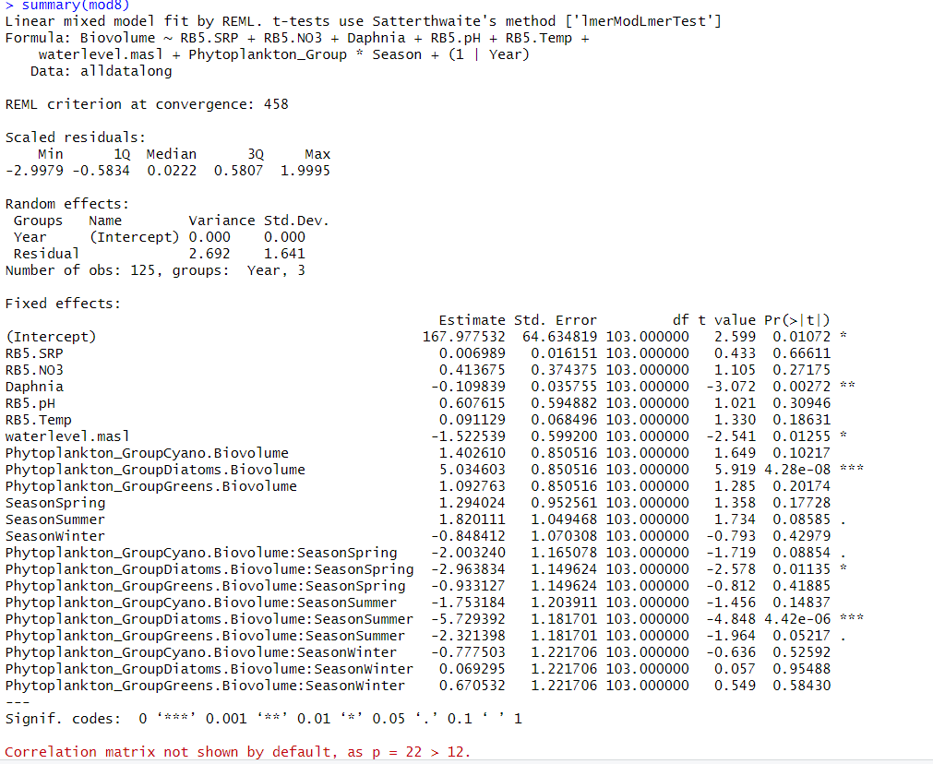

Slide 19
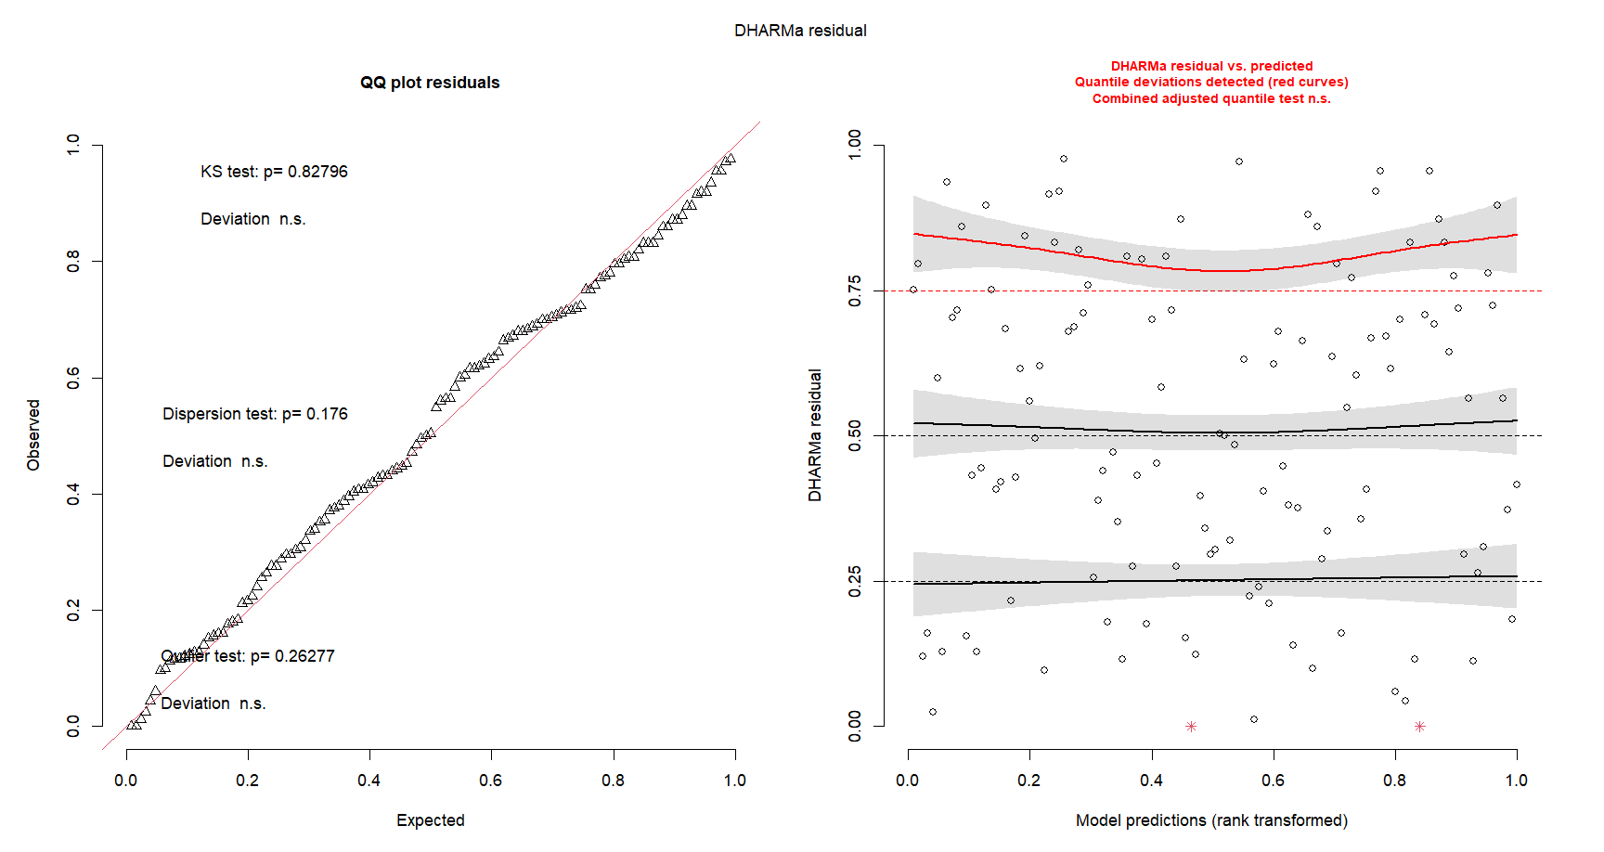

Slide 20
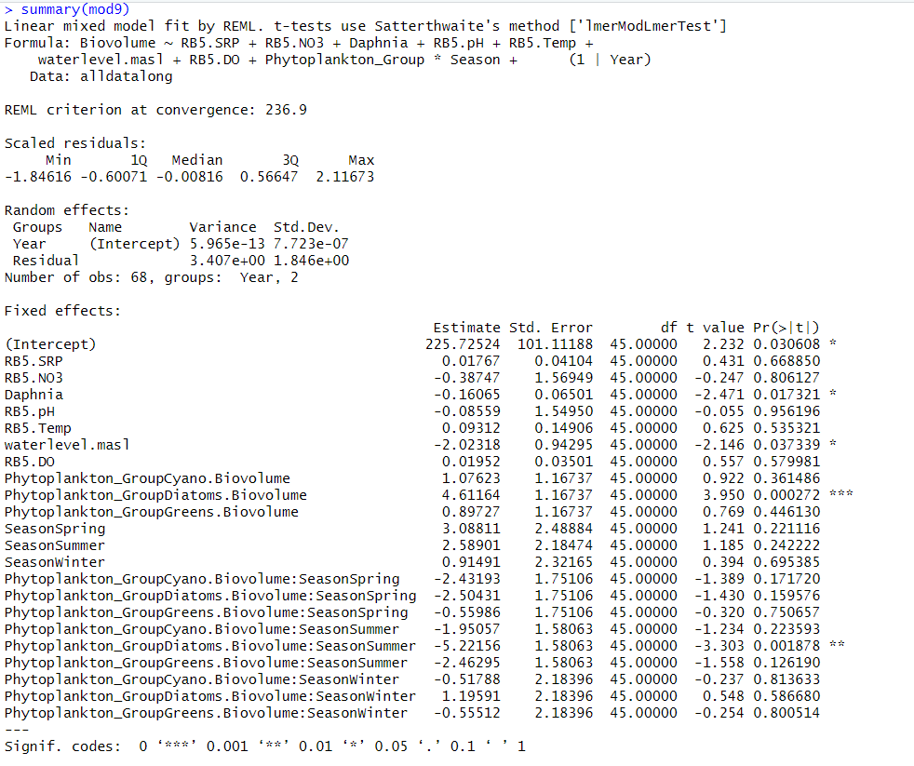

Slide 21
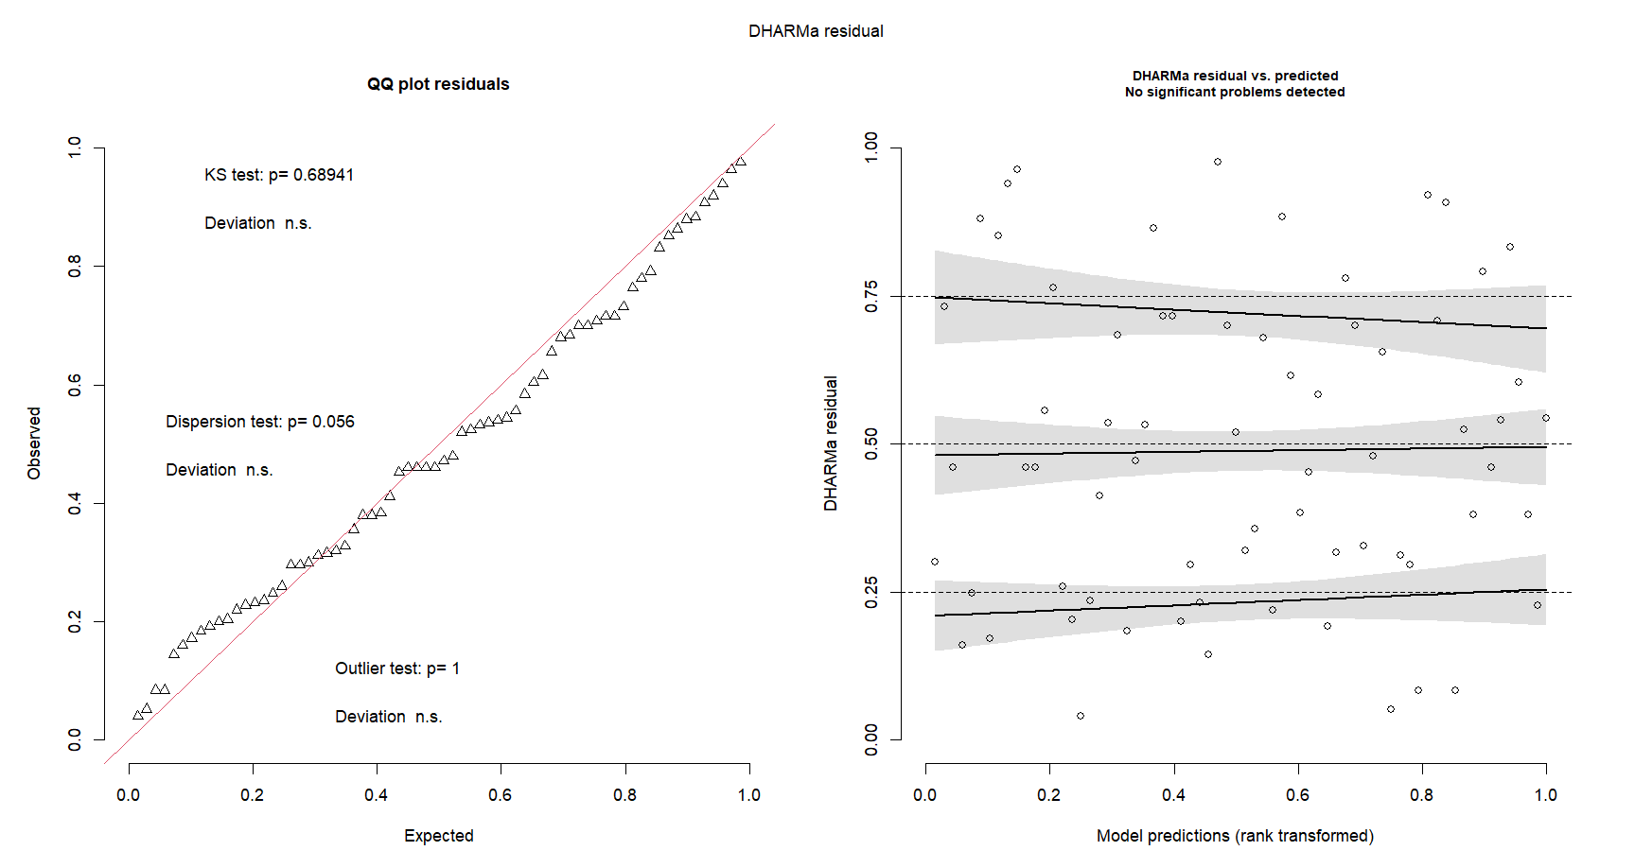

Slide 22
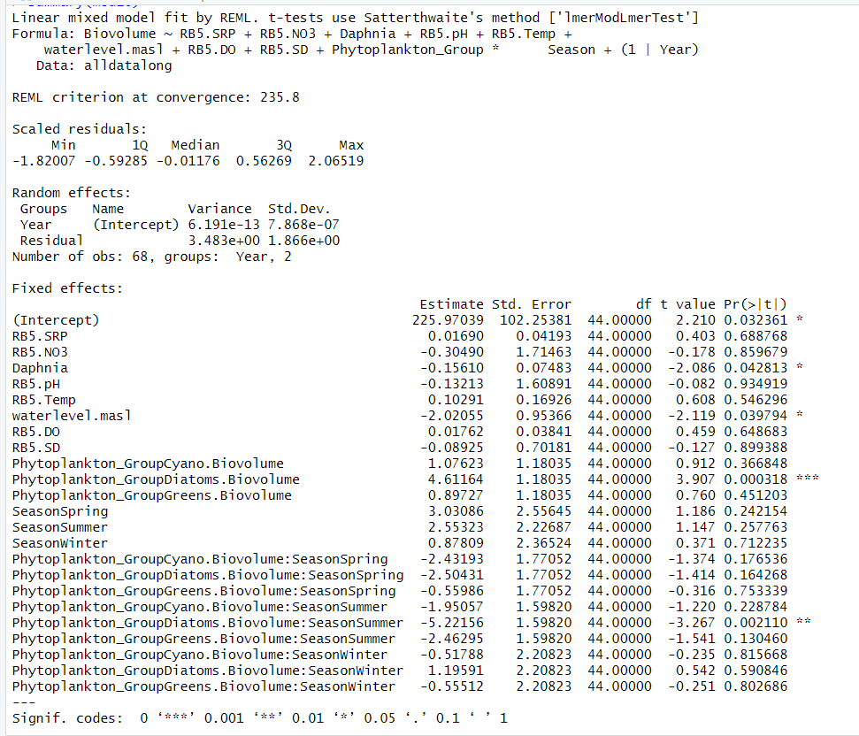

Slide 23
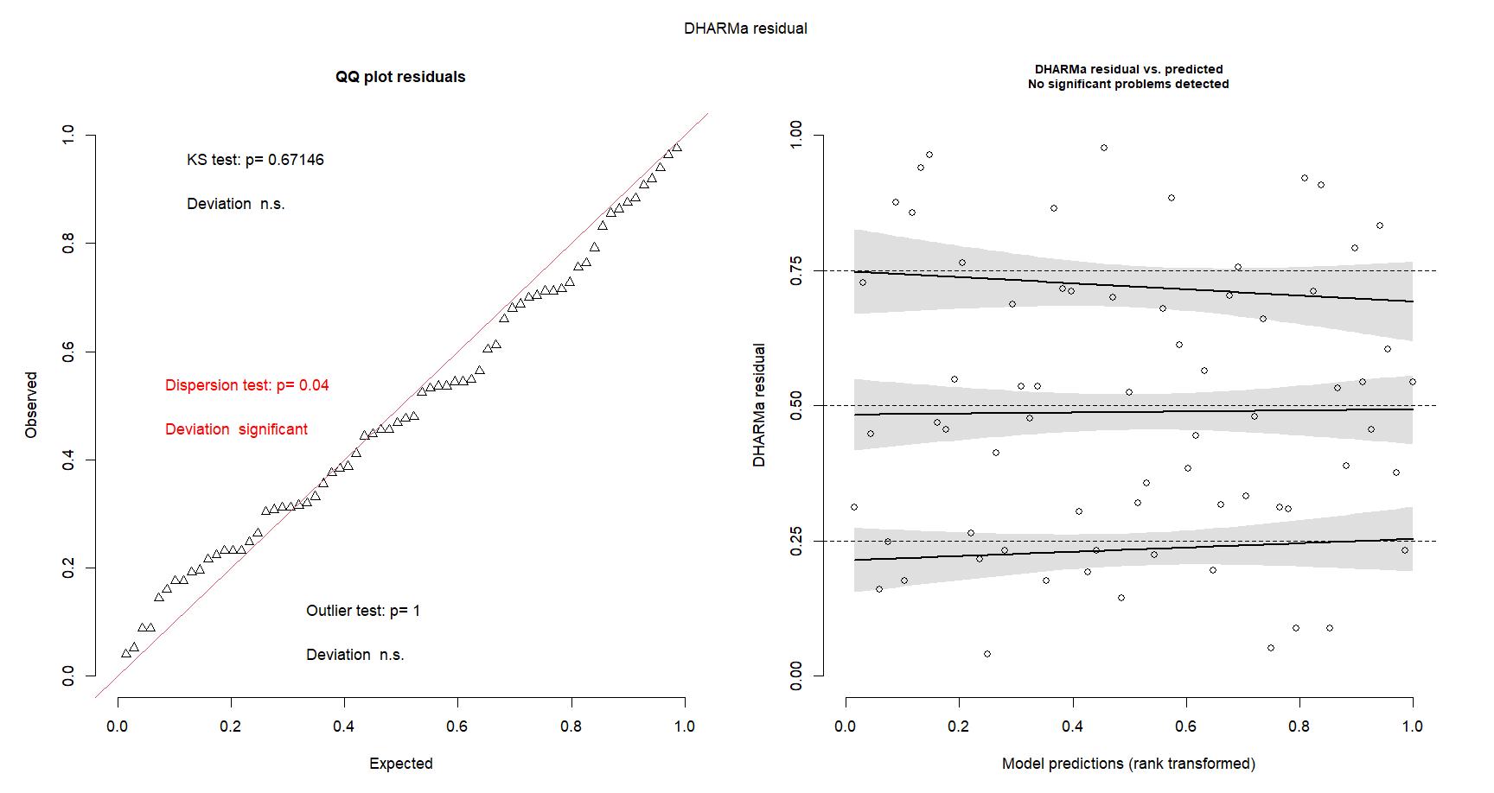

Slide 24
